Slide 1
7 Habits
Maturity Continuum

Slide 2
Paradigms and Principles
Maturity Continuum
Dependence
Paradigm of YOU
Independence
Paradigm of I
InterDependence
Paradigm of WE

Slide 3
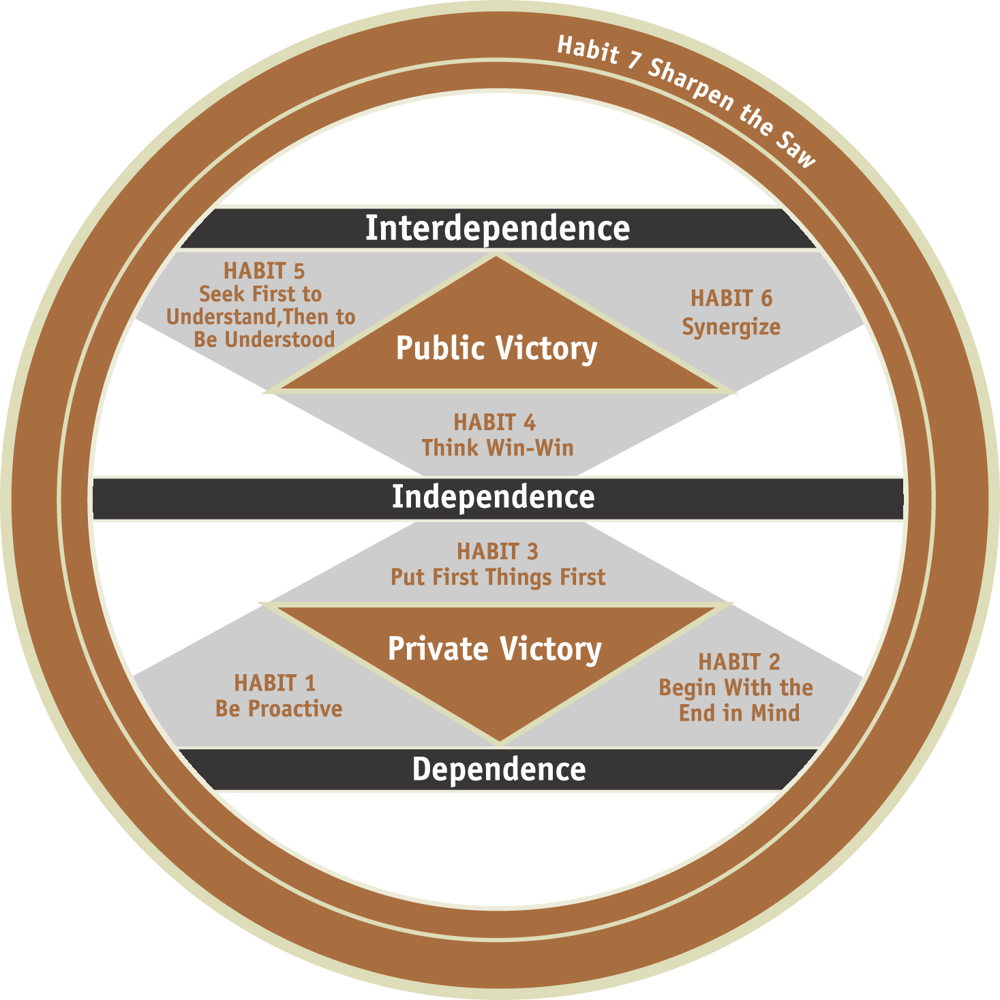
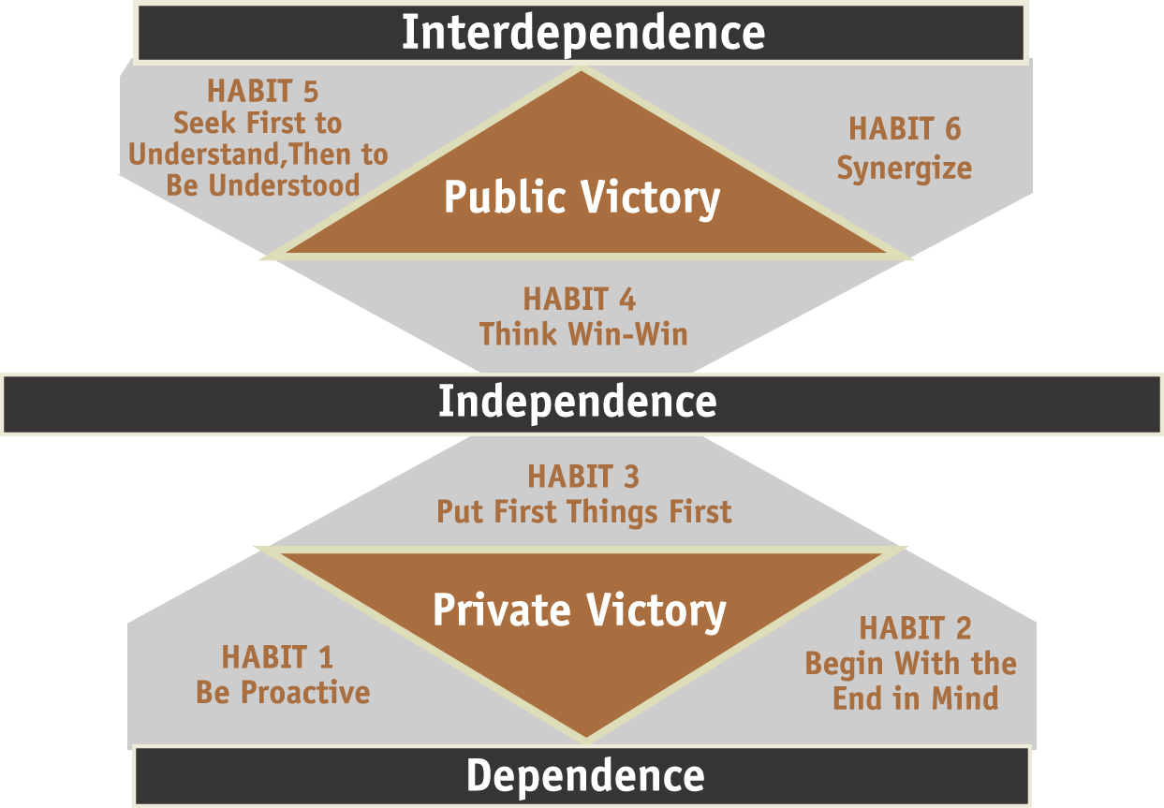
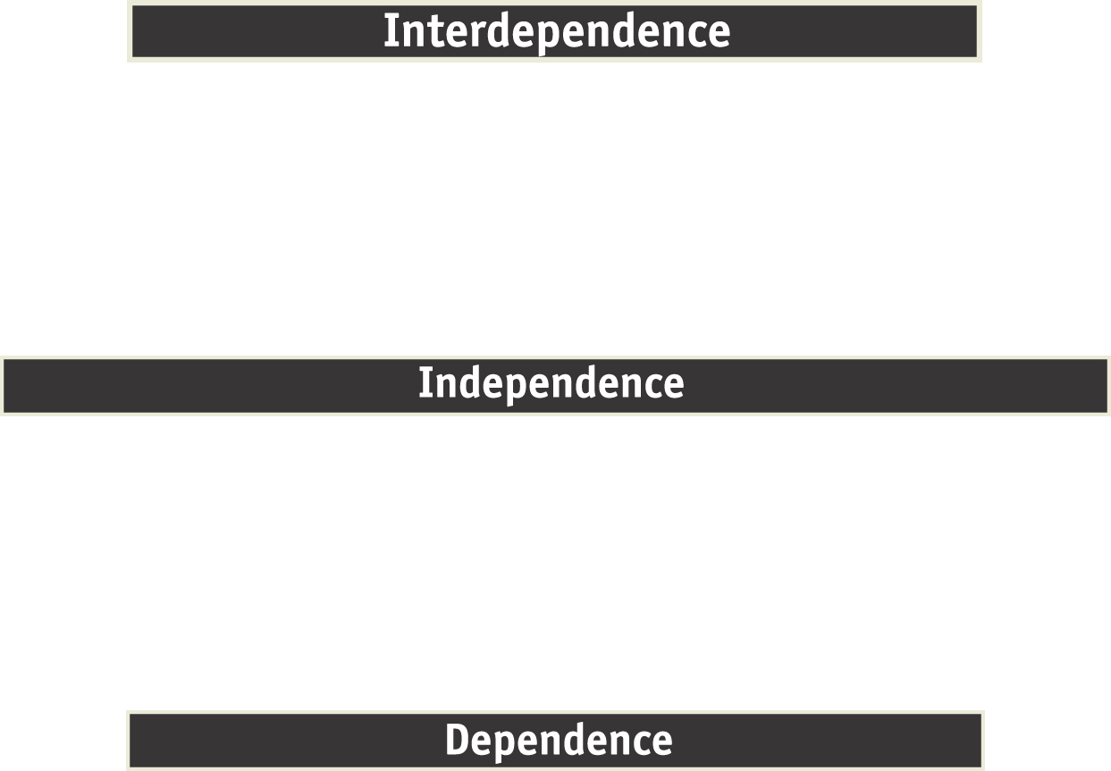
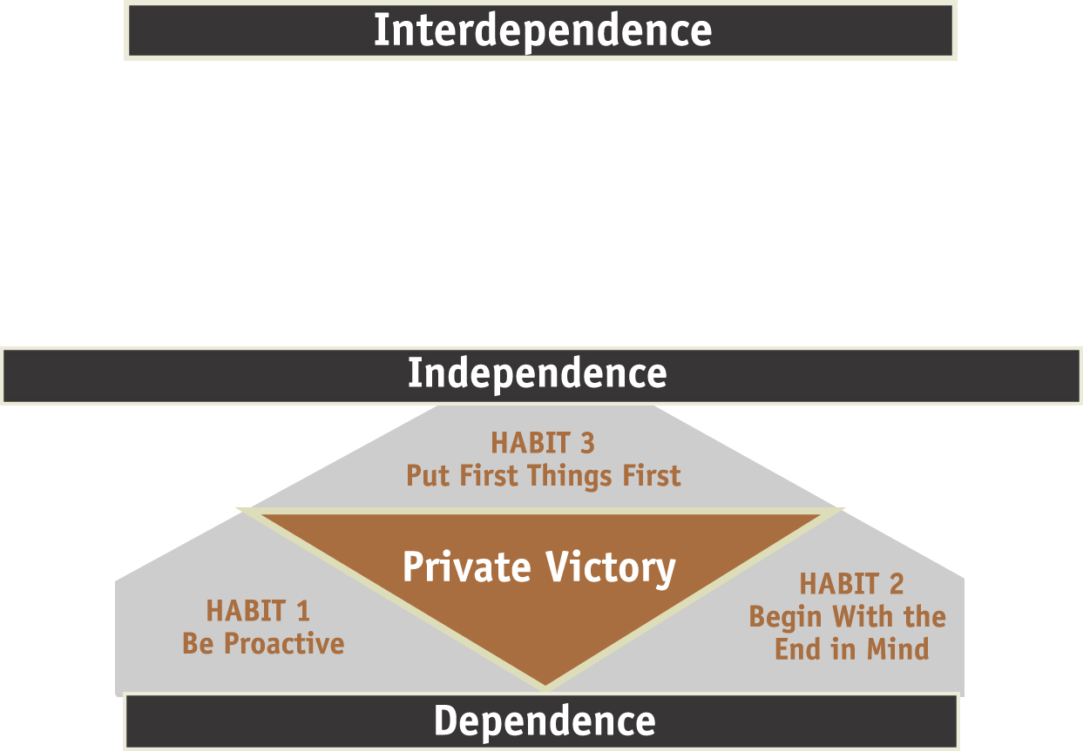

The Stages of the Maturity Continuum
Foundation
5

